Slide 1
GPS and Interactive Maps in React

Slide 2

Install the map libraries
Open your VS Code terminal inside your project folder, type
Then create SurveyMap.jsx in src/components folder
Create MapPage.jsx in src/pages folder

Slide 3
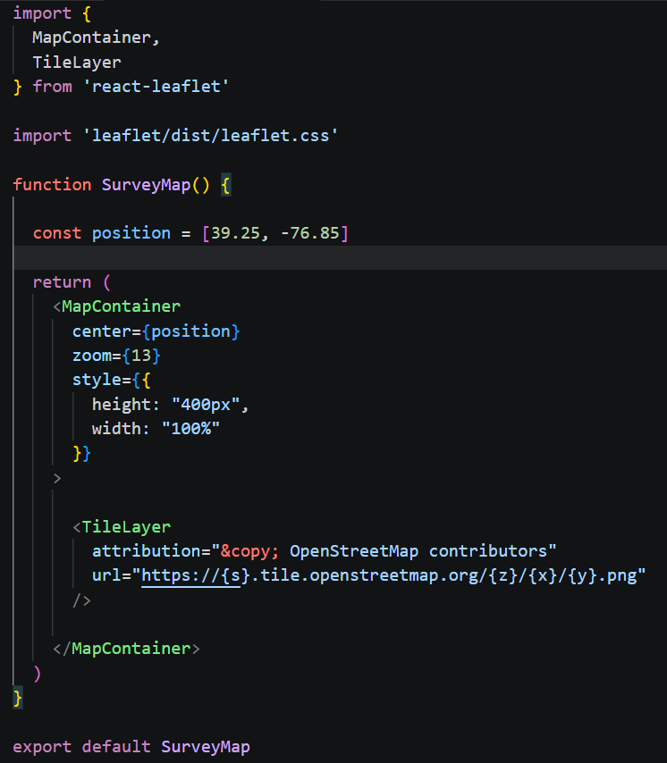
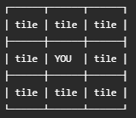
Display our first map
In SurveyMap.jsx, enter:
What is a tile map?
  We’re not downloading one gigantic image of the world.
  The map is broken into small images called tiles:
  As you pan or zoom, the map loads the necessary tiles.
Represent
[latitude, longitude]

Slide 4
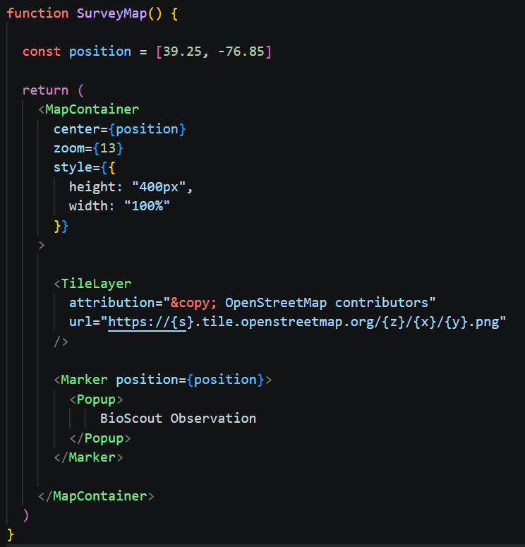
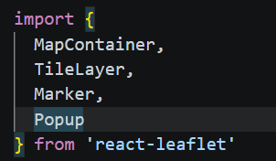
Put a marker on the map
Import Marker and Popup
Then in function SurveyMap(), add:

Slide 5
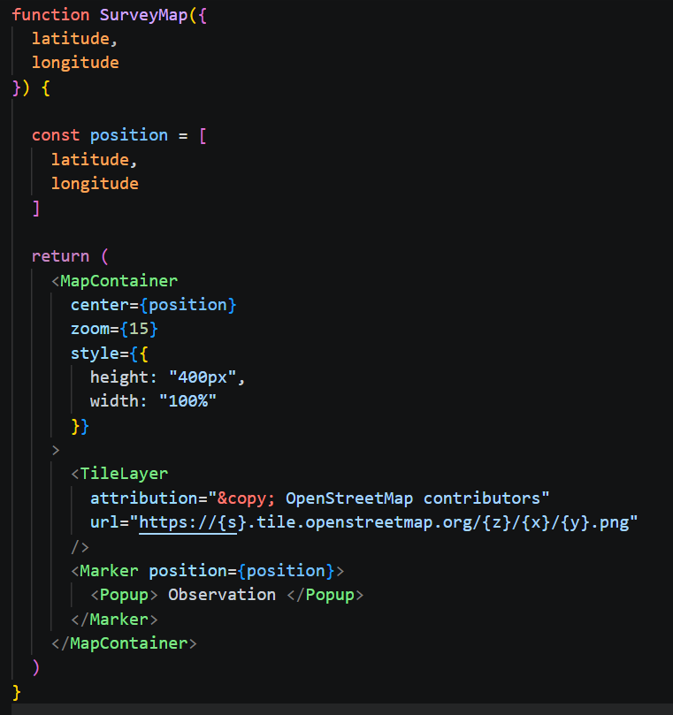



Make the coordinates props
Hard-coded coordinates aren’t very useful.
Change:
to :
Then:
Next, we will use phone’s GPS to get the latitude and longitude info and pass the values to SurveyMap () function.

Slide 6
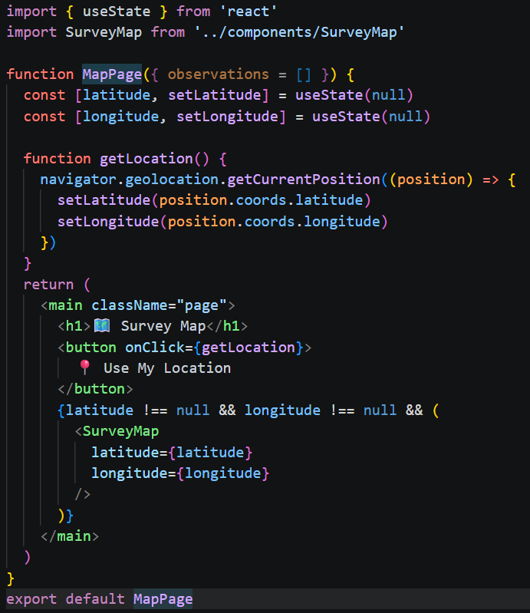
Get the phone’s GPS
In MapPage.jsx, create GPS state:
  We start with null, because we don’t know the position yet.
Create a “Use My Location” button
When users click the button, React will run function getLocation ()
This line will get location from GPS
Show the GPS location on the map
** How to insert emoji in Visual Studio code
  Windows: Press Windows Key + . or Windows Key + ; to open the emoji picker.
  macOS: Press Control + Command + Space.

Slide 7
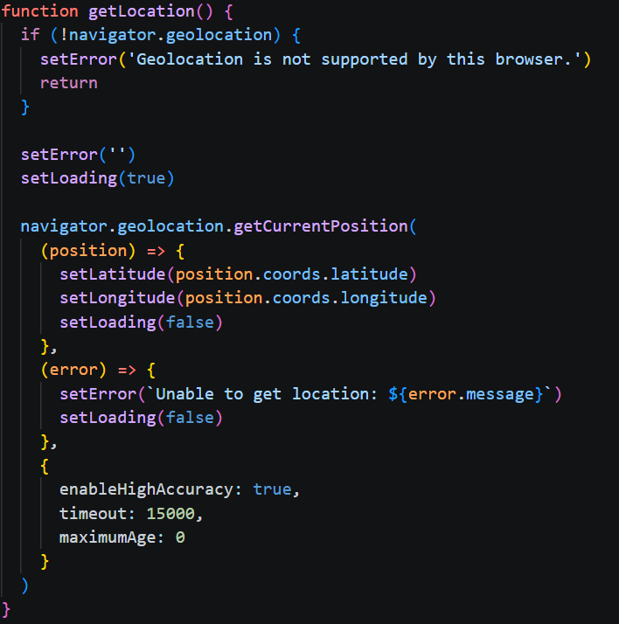

Add error handling and loading
GPS can fail for several reasons:
  User denies permission
  GPS unavailable
  Location timeout
  Browser doesn’t support geolocation
Let’s handle those cases.
Add:
Then improve getLocation( ):
Add options for getCurrentPostion():

Slide 8
Understanding the GPS options
Option | Meaning
enableHighAccuracy: true | Requests the most accurate available positioning
maximumAge: 0 | Requests fresh rather than cached positions
timeout: 10000 | Allows up to 10 seconds for a position acquisition attempt

Slide 9
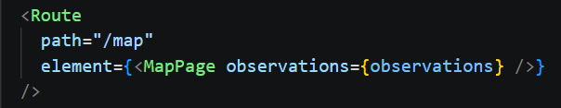

Add map page in the App
In App.jsx, add MapPage route:
In Navigation.jsx, add a link to map:

